Slide 1
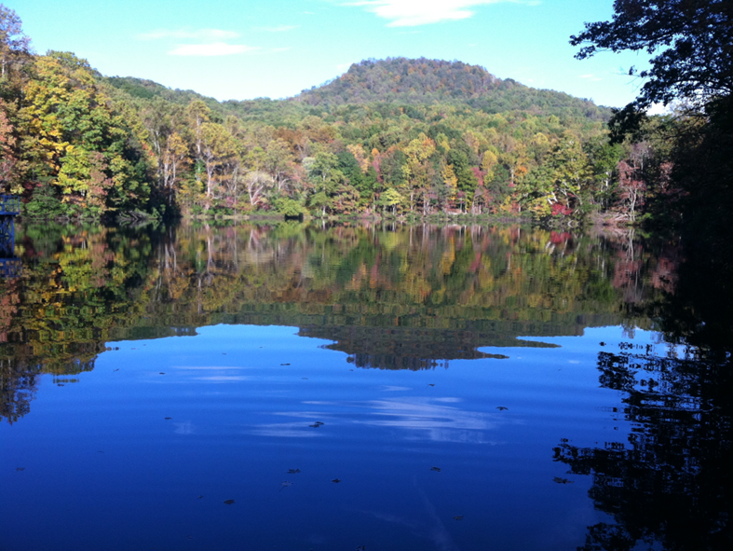

Challenge Case III “Sensor Data QA/QC”: Falling Creek Reservoir, Virginia, USA
Photo Credit:
C. Carey
Jonathan P. Doubek & Cayelan C. Carey
PRAGMA 27
15 October 2014
jpdoubek@vt.edu

Slide 2
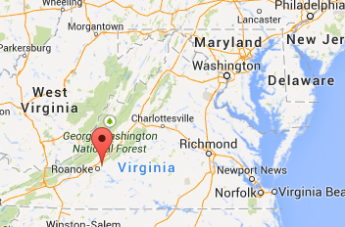
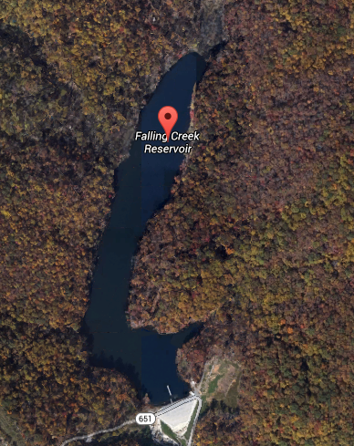
Falling Creek Reservoir, Virginia, USA
Small reservoir: 9.3 m max depth, 0.1 km² surface area
Eutrophic (poor water quality)
Drinking water for Roanoke, VA
2013

Slide 3
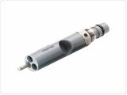
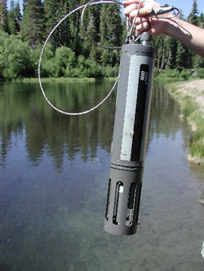
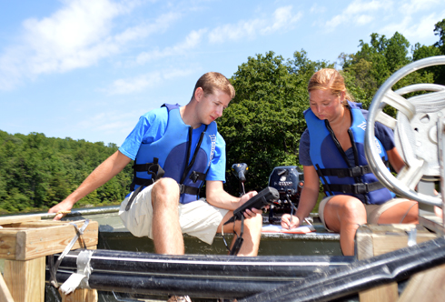
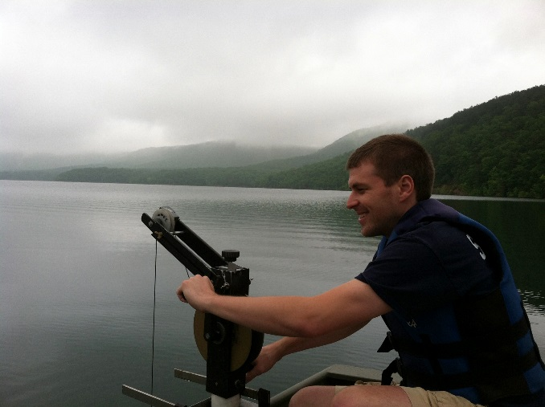
Temperature & Dissolved Oxygen Sensors
Dissolved oxygen (DO) is important for many aquatic organisms
Decreased DO can release nutrients & metals from the sediments → algal blooms and water treatment plant problems, as well as fish kills
Increased temperature favors toxic cyanobacteria and algal blooms
2013

Slide 4
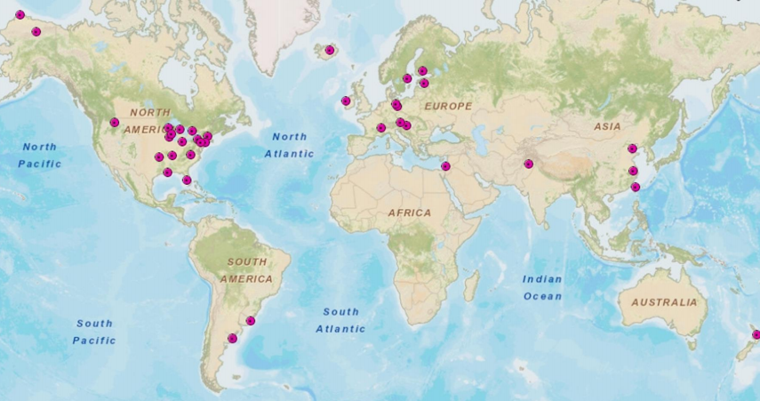
Importance of High-frequency Data
Partnership with Global Lake Ecological Observatory Network (GLEON)
- high-frequency buoys across the globe
- measure water quality data to help us better predict fine-scale phenomena like algal blooms and make lake management decisions
- important to have efficient QA/QC and coding of data → lots of data!
2013

Slide 5
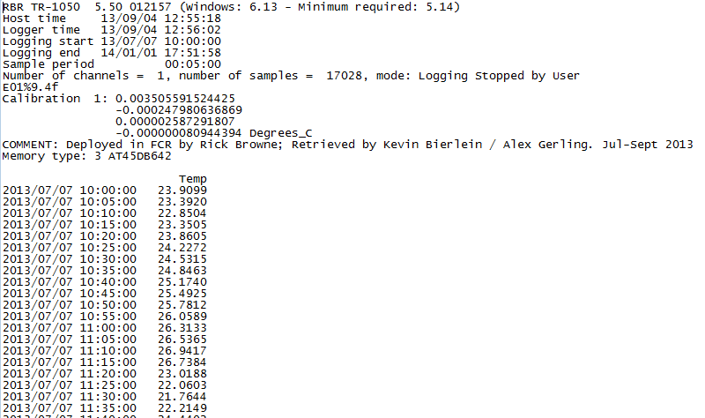
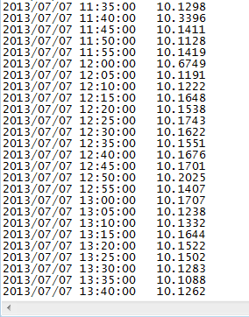
Thermistor Data
1 meter depth
2013
8 meters

Slide 6
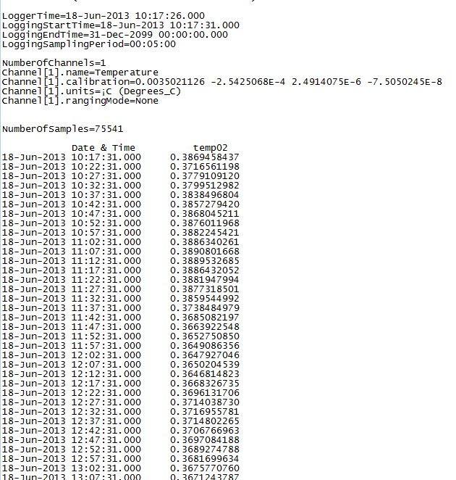
Erroneous Thermistor Data
Temperature at 1 m
2013

Slide 7
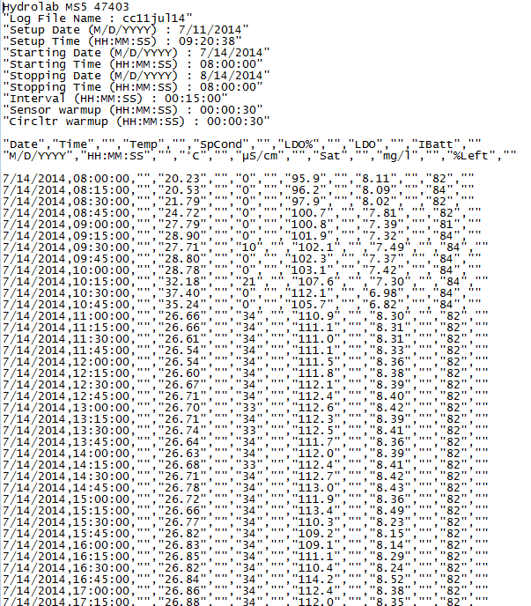
DO Working Data
DO at 1 m

Slide 8
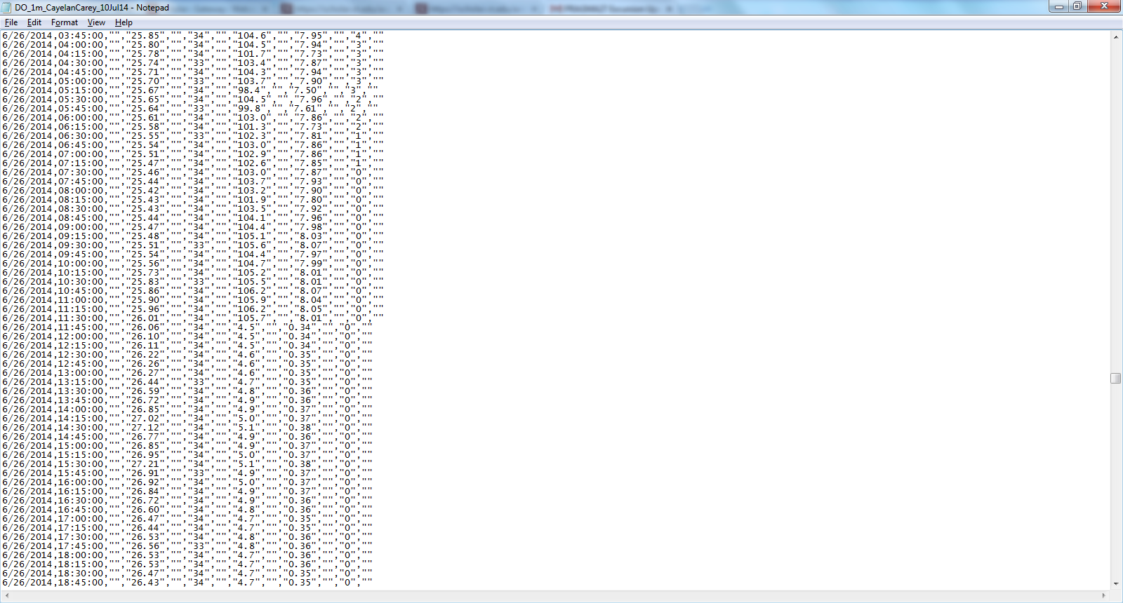
Erroneous DO Data
Battery died
DO → 0 Volts, 0% internal battery, DO crashed

Slide 9
High-frequency Data Issues
Outliers (e.g., DO >15 mg/L or a negative number)
Low battery screening
Consecutive data points
Drift
Algal growth on sensor can result in biofouling, causing an incorrect DO upwards

Slide 10
QA/QC Activity
Automate different scripts for QA/QC of data for Falling Creek Reservoir
1) Thermistor data at multiple depths
2) DO data at multiple depths
GOAL: create scripts that can process sensor data files, flag outliers and erroneous values, plot the data, and write different .txt files
.txt files that removes the outliers and sensor drift
.txt files that leaves the raw data but adds flags

Slide 11
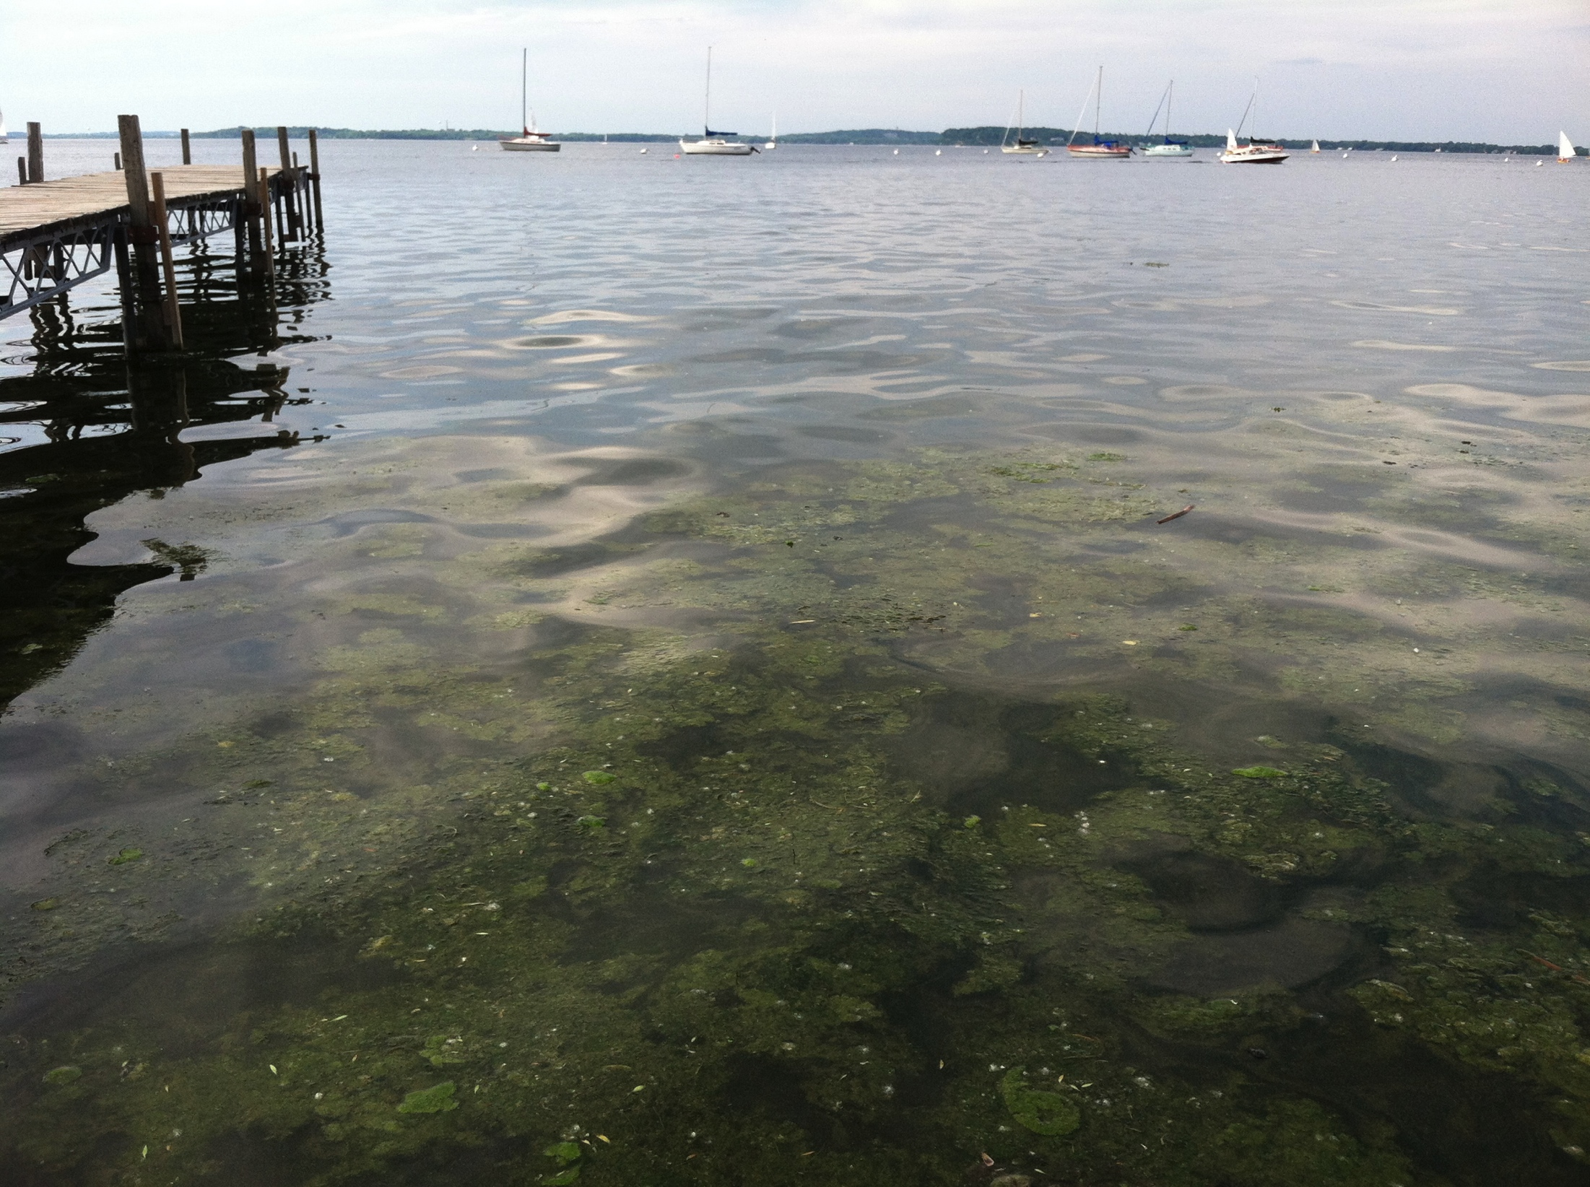
Questions?

